Slide 1
UNIT 1 Fundamentals of Technical Communication
TYPES OF COMMUNICATION

Slide 2
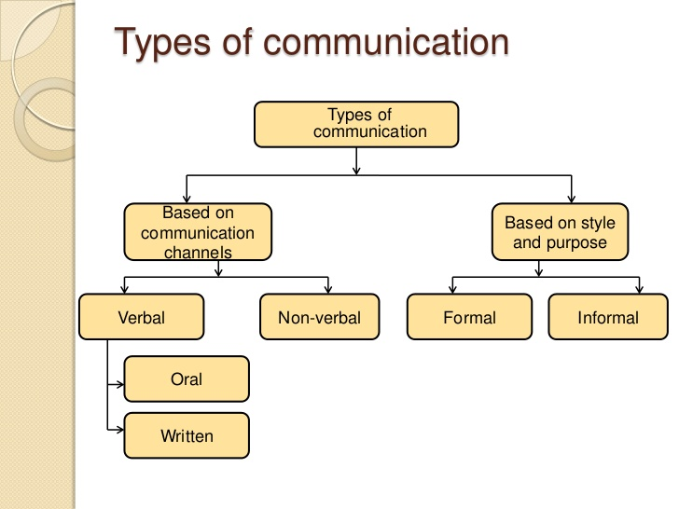

Slide 3
FORMAL COMMUNICATION
‘Formal Communication’ is the transmission of infor­mation in formal organizational structure and in specific direction.
The purposes of formal communication are to give orders, convey instructions and fulfill the objectives of the organization through some pre-determined rules and regulations.
Letters, reports, memos, speeches, e-mail, internet, website, etc. are used in the case of formal communi­cation.
In the case of formal communication feedback requires some time due to completion of formal procedure.
Formal communication is time-consuming and costly.
It is official and formal in nature.
It requires sanction of the higher authority.
Flexibility is not found in it. It is generally rigid in nature.

Slide 4
It is generally written.
Formal communication being written and structured is transparent. Hence it is reliable.
Formal communication flows in a systematic manner according to the procedure. It takes its own time.
Generally formal communication moves both downward and upward.
Personal influence is almost nil in such communication.
Person giving wrong information can be located and be made responsible or the offence.
Information is reliable, correct, factual and standard in it.
Formal communication is routine type and systematic.

Slide 5
INFORMAL COMMUNICATION
Informal communication is the communication on the basis of informal relations and understanding among the people at the same or different levels.
The purposes of informal communication are to build up informal relationship through personal contacts, sharing of information , etc.
Usually verbal channels( e.g., face to face conversations, telephone calls, gossips, etc.) are used in the case of informal communication.
Feedback is immediate.
It is unofficial and informal in nature.

Slide 6
No sanction of the higher authority is required.
It is loose and very much flexible.
There is every possibility of information being inaccurate and half true in it and hence it is not dependable and trust­worthy.
Informal communication does not follow any struc­tured route or process.
It is mostly verbal.
Informal communication is less transparent because gossip generates concocted stories and rumor. It lacks reliability.
Informal communication is fast-flowing specially in the case of rumors.
Informal communication moves towards any direction —upward, downward, side- wise, parallel, etc..
Personal influence is the basis of such communi­cation. Personal opinion, suggestion, views, liking, etc. are very important here.
No one can be made respon­sible for any distorted infor­mation or rumor as the source of information is difficult to locate here.

Slide 7
BASED ON COMMUNICATION CHANNEL VERBAL COMMUNICATION
The Verbal Communication is a type of oral communication wherein the message is transmitted through the spoken words. Here the sender gives words to his feelings, thoughts, ideas and opinions and expresses them in the form of speeches, discussions, presentations, and conversations.
The effectiveness of the verbal communication depends on the tone of the speaker, clarity of speech, volume, speed, body language and the quality of words used in the conversation.
In the case of the verbal communication, the feedback is immediate since there are a simultaneous transmission and receipt of the message by the sender and receiver respectively.

Slide 8
The sender must keep his speech tone high and clearly audible to all and must design the subject matter keeping the target audience in mind.
The sender should always cross check with the receiver to ensure that the message is understood in absolutely the same way as it was intended. Such communication is more prone to errors as sometimes the words are not sufficient to express the feelings and emotions of a person.
The success of the verbal communication depends not only on the speaking ability of an individual but also on the listening skills. How effectively an individual listens to the subject matter decides the effectiveness of the communication.
The verbal communication is applicable in both the formal and informal kind of situations.

Slide 9
2. Nonverbal
Nonverbal communication is the use of body language, gestures and facial expressions to convey information to others.
It can be used both intentionally and unintentionally.
A substantial portion of our communication is nonverbal. Experts have found that every day we respond to thousands of nonverbal cues and behaviors including postures, facial expressions, eye gaze, gestures, and tone of voice. From our handshakes to our hairstyles, nonverbal details reveal who we are and impact how we relate to other people.

Slide 10
Types of Non- Verbal Communication
Facial expressions
Gestures
Body language ( Kinesics)
Posture
Proxemics or personal space
Eye gaze
Haptics (touch)
Appearance
Artifact

Slide 11
Facial Expressions
Facial expressions are responsible for a huge proportion of nonverbal communication.﻿ Consider how much information can be conveyed with a smile or a frown. The look on a person's face is often the first thing we see, even before we hear what they have to say.
While nonverbal communication and behavior can vary dramatically between cultures, the facial expressions for happiness, sadness, anger, and fear are similar throughout the world.

Slide 12
Gestures
Deliberate movements and signals are an important way to communicate meaning without words.
Common gestures include waving, pointing, and using fingers to indicate numeric amounts. Other gestures are arbitrary and related to culture.
Gesture clarify our ideas or reinforce them and should be well suited to the audience and occasion.
Gesture should not divert the attention of the listener from one’s message. They should be quite natural and spontaneous.

Slide 13
Types of Gesture
Enumerative – number
Descriptive - size of the object
Symbolic - abstract concepts
Locative - location of an object
Emphatic - emphasis

Slide 14
Body Language (KINESICS)
Kinesics is the study of the body’s physical movements
Some kinesics behaviors are deliberate. For ex – you nod your head to indicate acceptance.
In face to face communication, the message is conveyed on two levels simultaneously. One is verbal and the other is non-verbal.
While these nonverbal behaviors can indicate feelings and attitudes, research suggests that body language is far more subtle and instinctive, and often involuntary.

Slide 15
POSTURE
Posture generally refers to the way we hold ourselves when we stand sit, or walk.
One’s posture changes according to the situation.
If nervous, one would normally be seen pacing, bobbing the shoulders, fidgeting with notes, jingling coins, moving constantly, or staying glued to the ground.
When we are with friends we are probably spontaneous.

Slide 16
Types of Posture
Slumped posture low spirits
Erect posture high spirits, energy, and confidence
Lean forward open, honest, and interested
Lean backward defensive or disinterested
Crossed arms defensive and not ready to listen
Uncrossed arms willingness to listen

Slide 17
Proxemics
People often refer to their need for "personal space," which is also an important type of nonverbal communication.
﻿ The amount of distance we need and the amount of space we perceive as belonging to us is influenced by a number of factors including social norms, cultural expectations, situational factors, personality characteristics, and level of familiarity.
The amount of personal space needed when having a casual conversation with another person usually varies between 18 inches to four feet. On the other hand, the personal distance needed when speaking to a crowd of people is around 10 to 12 feet.

Slide 18
Eye Gaze
The eyes play an important role in nonverbal communication and such things as looking, staring and blinking are important nonverbal behaviors.
When people encounter people or things that they like, the rate of blinking increases and pupils dilate. Looking at another person can indicate a range of emotions including hostility, interest, and attraction.
People also utilize eye gaze as a means to determine if someone is being honest. Normal, steady eye contact is often taken as a sign that a person is telling the truth and is trustworthy. Shifty eyes and an inability to maintain eye contact, on the other hand, is frequently seen as an indicator that someone is lying or being deceptive.

Slide 19
Haptics
Communicating through touch is another important nonverbal behavior. There has been a substantial amount of research on the importance of touch in infancy and early childhood.
Touch can be used to communicate affection, familiarity, sympathy, and other emotions.
Touch is also often used as a way to communicate both status and power.﻿
Researchers have found that high-status individuals tend to invade other people's personal space with greater frequency and intensity than lower-status individuals. Sex differences also play a role in how people utilize touch to communicate meaning.
Women tend to use touch to convey care, concern, and nurturance. Men, on the other hand, are more likely to use touch to assert power or control over others.

Slide 20
Appearance
Our choice of color, clothing, hairstyles, and other factors affecting appearance are also considered a means of nonverbal communication.8﻿ Research on color psychology has demonstrated that different colors can evoke different moods. Appearance can also alter physiological reactions, judgments, and interpretations.
Just think of all the subtle judgments you quickly make about someone based on his or her appearance. These first impressions are important, which is why experts suggest that job seekers dress appropriately for interviews with potential employers.
Researchers have found that appearance can play a role in how people are perceived and even how much they earn. One 1996 study found that attorneys who were rated as more attractive than their peers earned nearly 15 percent more than those ranked as less attractive.

Slide 21
Artifacts
Objects and images are also tools that can be used to communicate nonverbally. On an online forum, for example, you might select an avatar to represent your identity online and to communicate information about who you are and the things you like.
People often spend a great deal of time developing a particular image and surrounding themselves with objects designed to convey information about the things that are important to them.
Uniforms, for example, can be used to transmit a tremendous amount of information about a person.
A soldier will don fatigues, a police officer will wear a uniform, and a doctor will wear a white lab coat. At a mere glance, these outfits tell people what a person does for a living.

